Slide 1
Introduction to Data Communication Model

Slide 2

It is the physical transfer of data over a point to point or point to multipoint communication channel.
Data communications deals with the transmission of signals in a reliable and efficient manner.
Networking deals with the technology and architecture of the communications networks used to interconnect communicating devices.

Slide 3
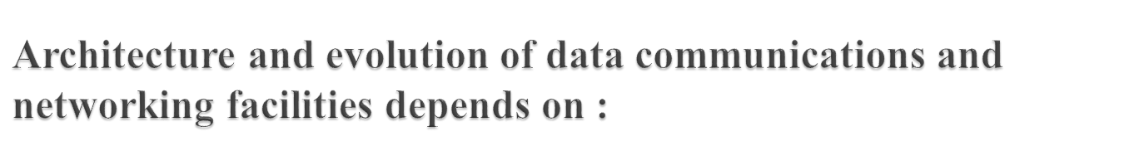
Traffic growth
Services
Technology
Notes:
Effective and efficient data communication and networking facilities are vital to any enterprise.
Three different forces have consistently driven the architecture and evolution of data communications and networking facilities: traffic growth, development of new services, and advances in technology.
Traffic: growing at a high and steady rate, the increasing emphasis on automation, remote access and online transaction means that this trend is likely to continue. (Maximize capacity and minimize cost )
Service: The drop in communication price encourages the expansion of service thus growth in service and traffic capacity go hand in hand.
Technology: Enable provision of increasing traffic capacity and support of wide range of services.

Slide 4

Delivery
Accuracy
Timeliness

Slide 5


Slide 6

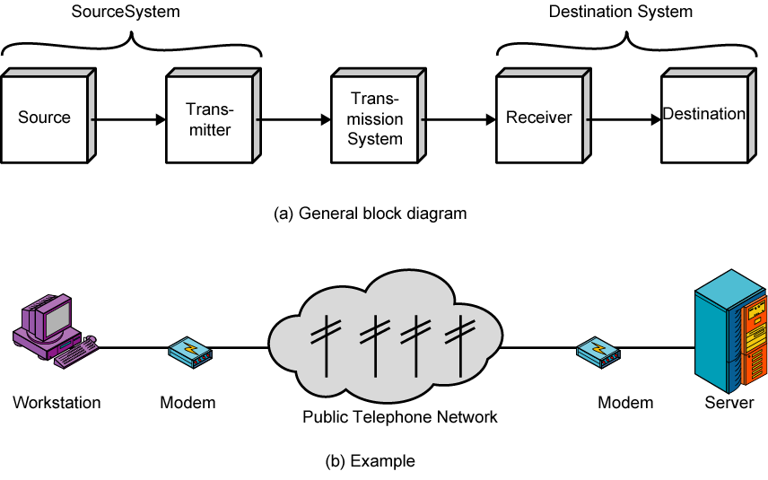
Notes:
The fundamental purpose of a communications system is the exchange of data between two parties. The key elements of this model are:
Source - generates data to be transmitted
Transmitter - converts data into transmittable signals
Transmission System - carries data from source to destination
Receiver - converts received signal into data
Destination - takes incoming data

Slide 7

Transmission system utilization | Addressing
Interfacing | Routing
Signal generation | Recovery
Synchronization | Message formatting
Exchange management | Security
Error detection and correction | Network management
Flow control
Notes:
transmission system utilization - need to make efficient use of transmission facilities typically shared among a number of communicating devices
a device must interface with the transmission system
once an interface is established, signal generation is required for communication
there must be synchronization between transmitter and receiver, to determine when a signal begins to arrive and when it ends
there is a variety of requirements for communication between two parties that might be collected under the term exchange management
Error detection and correction are required in circumstances where errors cannot be tolerated
Flow control is required to assure that the source does not overwhelm the destination by sending data faster than they can be processed and absorbed
addressing and routing, so a source system can indicate the identity of the intended destination, and can choose a specific route through this network
Recovery allows an interrupted transaction to resume activity at the point of interruption or to condition prior to the beginning of the exchange
Message formatting has to do with an agreement between two parties as to the form of the data to be exchanged or transmitted
Frequently need to provide some measure of security in a data communications system
Network management capabilities are needed to configure the system, monitor its status, react to failures and overloads, and plan intelligently for future growth
See have gone from the simple idea of data communication between source and destination to a rather formidable list of data communications tasks.

Slide 8

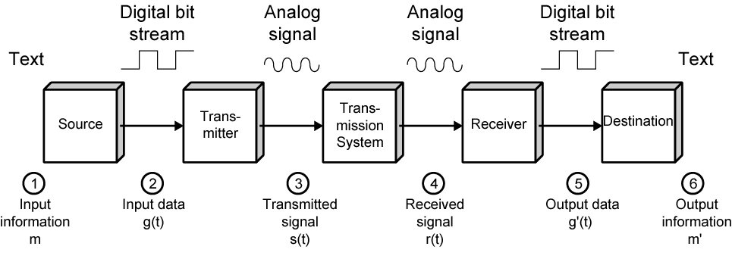
Notes:
The process is modeled as follows:
user keys in message m comprising bits g buffered in source PC memory
input data is transferred to I/O device (transmitter) as sequence of bits g(t) using voltage shifts
transmitter converts these into a signal s(t) suitable for transmission media being used
whilst transiting media signal may be impaired so received signal r(t) may differ from s(t)
receiver decodes signal recovering g’(t) as estimate of original g(t)
which is buffered in destination PC memory as bits g’ being the received message m’

Slide 9

Medium used to transmit data.
Ex. Cable, air etc.

Slide 10
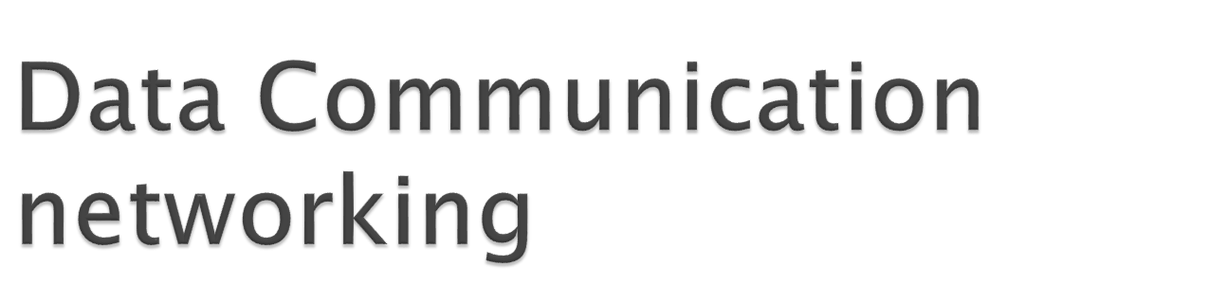

Slide 11

Growth of number & power of computers is driving need for interconnection
Rapid integration of voice, data, image & video technologies
Two broad categories of communications networks:
  Local Area Network (LAN)
  Wide Area Network (WAN)
Notes:
The number of computers in use worldwide is in the hundreds of millions, with pressure from users of these systems for ways to communicate among all these machines being irresistible. Advances in technology have led to greatly increased capacity and the concept of integration, allowing equipment and networks to deal simultaneously with voice, data, image, and even video.
Have two broad categories of networks: Local Area Networks (LAN) and Wide Area Networks (WAN).

Slide 12

Span a large geographical area
Cross public rights of way
Rely in part on common carrier circuits
Alternative technologies used include:
  circuit switching
  packet switching
  frame relay
  Asynchronous Transfer Mode (ATM)
Notes:
Wide area networks generally cover a large geographical area, require the crossing of public right-of-ways, and rely at least in part on circuits provided by a common carrier. Typically, a WAN consists of a number of interconnected switching nodes. Traditionally, WANs have been implemented using one of two technologies: circuit switching and packet switching. More recently, frame relay and ATM networks have assumed major roles.

Slide 13

Uses a dedicated communications path established for duration of conversation
Comprising a sequence of physical links with a dedicated logical channel
eg. telephone network
Notes:
In a circuit-switching network, a dedicated communications path is established between two stations through the nodes of the network. That path is a connected sequence of physical links between nodes, with a logical channel dedicated to the connection. Data generated by the source station are transmitted along the dedicated path as rapidly as possible. The most common example of circuit switching is the telephone network.

Slide 14

Data sent out of sequence
Small chunks (packets) of data at a time
Packets passed from node to node between source and destination
Used for terminal to computer and computer to computer communications
Notes:
A packet-switching network uses a quite different approach, without need to dedicate transmission capacity along a path through the network. Rather, data is sent in a sequence of small chunks, called packets. Each packet is passed through the network from node to node along some path leading from source to destination. At each node, the entire packet is received, stored briefly, and then transmitted to the next node. Packet-switching networks are commonly used for terminal-to-computer and computer-to-computer communications.

Slide 15

Packet switching systems have large overheads to compensate for errors
Modern systems are more reliable
Errors can be caught in end system
Frame Relay provides higher speeds with most error control overhead removed
Notes:
Frame relay was developed to take advantage of high data rates and low error rates on modern WAN links. Whereas the original packet-switching networks were designed with a data rate to the end user of about 64 kbps, frame relay networks are designed to operate efficiently at user data rates of up to 2 Mbps. The key to achieving these high data rates is to strip out most of the overhead involved with error control.

Slide 16

ATM
Evolution of frame relay
Fixed packet (called cell) length with little overhead for error control
Works in the range from 10Mbps and in Gbps range.
Notes:
Asynchronous transfer mode (ATM), is a culmination of developments in circuit switching and packet switching. ATM can be viewed as an evolution from frame relay. ATM uses fixed-length packets, called cells. As with frame relay, ATM provides little overhead for error control, depending on the inherent reliability of the transmission system and on higher layers of logic in the end systems to catch and correct errors. By using a fixed packet length, the processing overhead is reduced even further for ATM compared to frame relay. The result is that ATM is designed to work in the range of 10s and 100s of Mbps, and in the Gbps range.

Slide 17

Smaller scope
  Building or small campus
Usually owned by same organization as attached devices
Data rates much higher
Switched LANs, eg Ethernet
Wireless LANs
Notes:
A LAN is a communications network that interconnects a variety of devices and provides a means for information exchange among those devices. The scope of the LAN is small, typically a single building or a cluster of buildings. It is usually the case that the LAN is owned by the same organization that owns the attached devices. The internal data rates of LANs are typically much greater than those of WANs.
LANs come in a number of different configurations. The most common are switched LANs and wireless LANs. The most common switched LAN is a switched Ethernet LAN, others are ATM & Fibre Channel LANs. Wireless networks provide advantages in the areas of mobility and ease of installation and configuration.

Slide 18

MAN
Middle ground between LAN and WAN
Private or public network
High speed
Large area
Notes:
Metropolitan Area Networks provide a middle ground between LANs and WANs, typically spanning a city / metro area with higher speed connections.

Slide 19

Internet evolved from ARPANET
  first operational packet network
  applied to tactical radio & satellite nets also
  had a need for interoperability
  led to standardized TCP/IP protocols
Notes:
The Internet evolved from the ARPANET, developed in 1969 by the Advanced Research Projects Agency (ARPA) of the U.S. Department of Defense. It was the first operational packet-switching network. The network was so successful that ARPA applied the same packet-switching technology to tactical radio communication (packet radio) and to satellite communication (SATNET). The need for interworking between these led to Vint Cerf and Bob Kahn of ARPA developing methods and protocols for such internetworking, which led eventually to the development of TCP/IP.

Slide 20

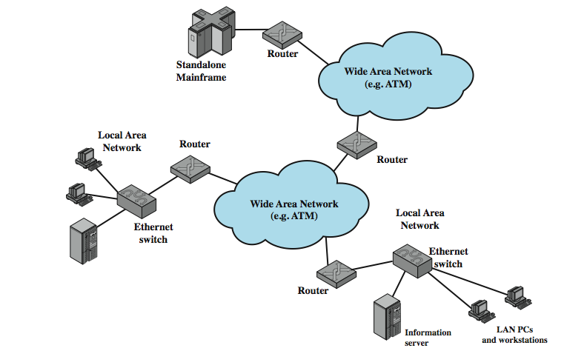
Notes:
the key elements that comprise the Internet, whose purpose is to interconnect end systems, called hosts; including PCs, workstations, servers, mainframes, and so on. Most hosts that use the Internet are connected to a network, such as a local area network (LAN) or a wide area network (WAN). These networks are in turn connected by routers.

Slide 21

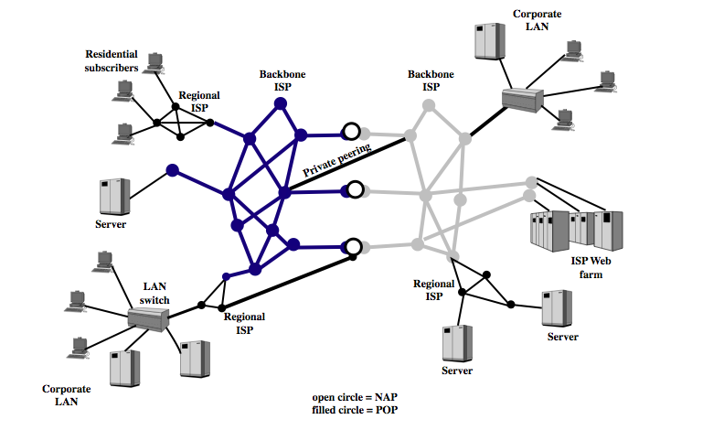
Notes:
The Internet today is made up of thousands of overlapping hierarchical networks, an overview of the common, general characteristics can be made.. See hosts grouped into LANs, linked to an an Internet service provider (ISP) through a point of presence (POP). The connection is made in a series of steps starting with the customer premises equipment (CPE). ISPs can be classified as regional or backbone, with peering links between.

Slide 22

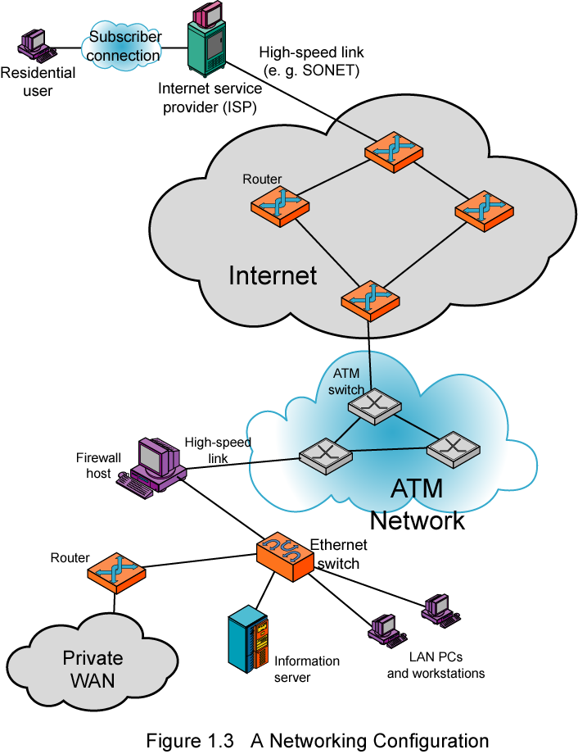
Notes:
In the upper-left-hand portion of the figure, we see an individual residential user connected to an Internet service provider (ISP) through some sort of subscriber connection. The Internet consists of a number of interconnected routers that span the globe. The routers forward packets of data from source to destination through the Internet. The lower portion shows a LAN implemented using a single Ethernet switch. This is a common configuration at a small business or other small organization.

